Slide 1



What transcriptomics can tell us about immune cell states
Maria Gutierrez-Arcelus, PhD
Assistant Professor
Boston Children’s Hospital
Harvard Medical School

Slide 2
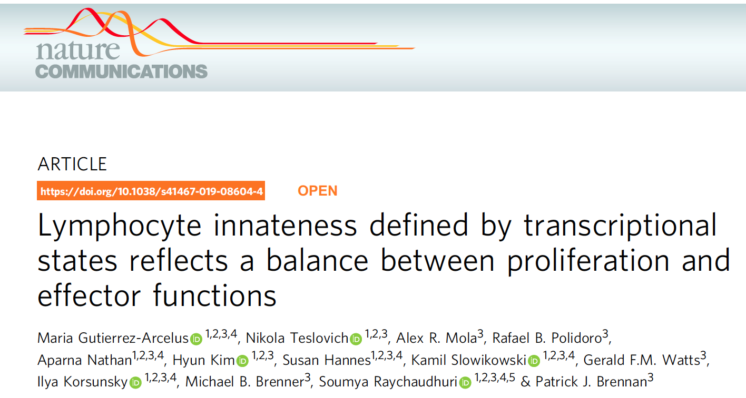
Notes:
This work was a close collaborations with Patrick Brennan and Michael Brenners groups. These are all the people that contributed to this project. I lead the data analysis part of this project and Patrick lead the experimental side of things.

Slide 3
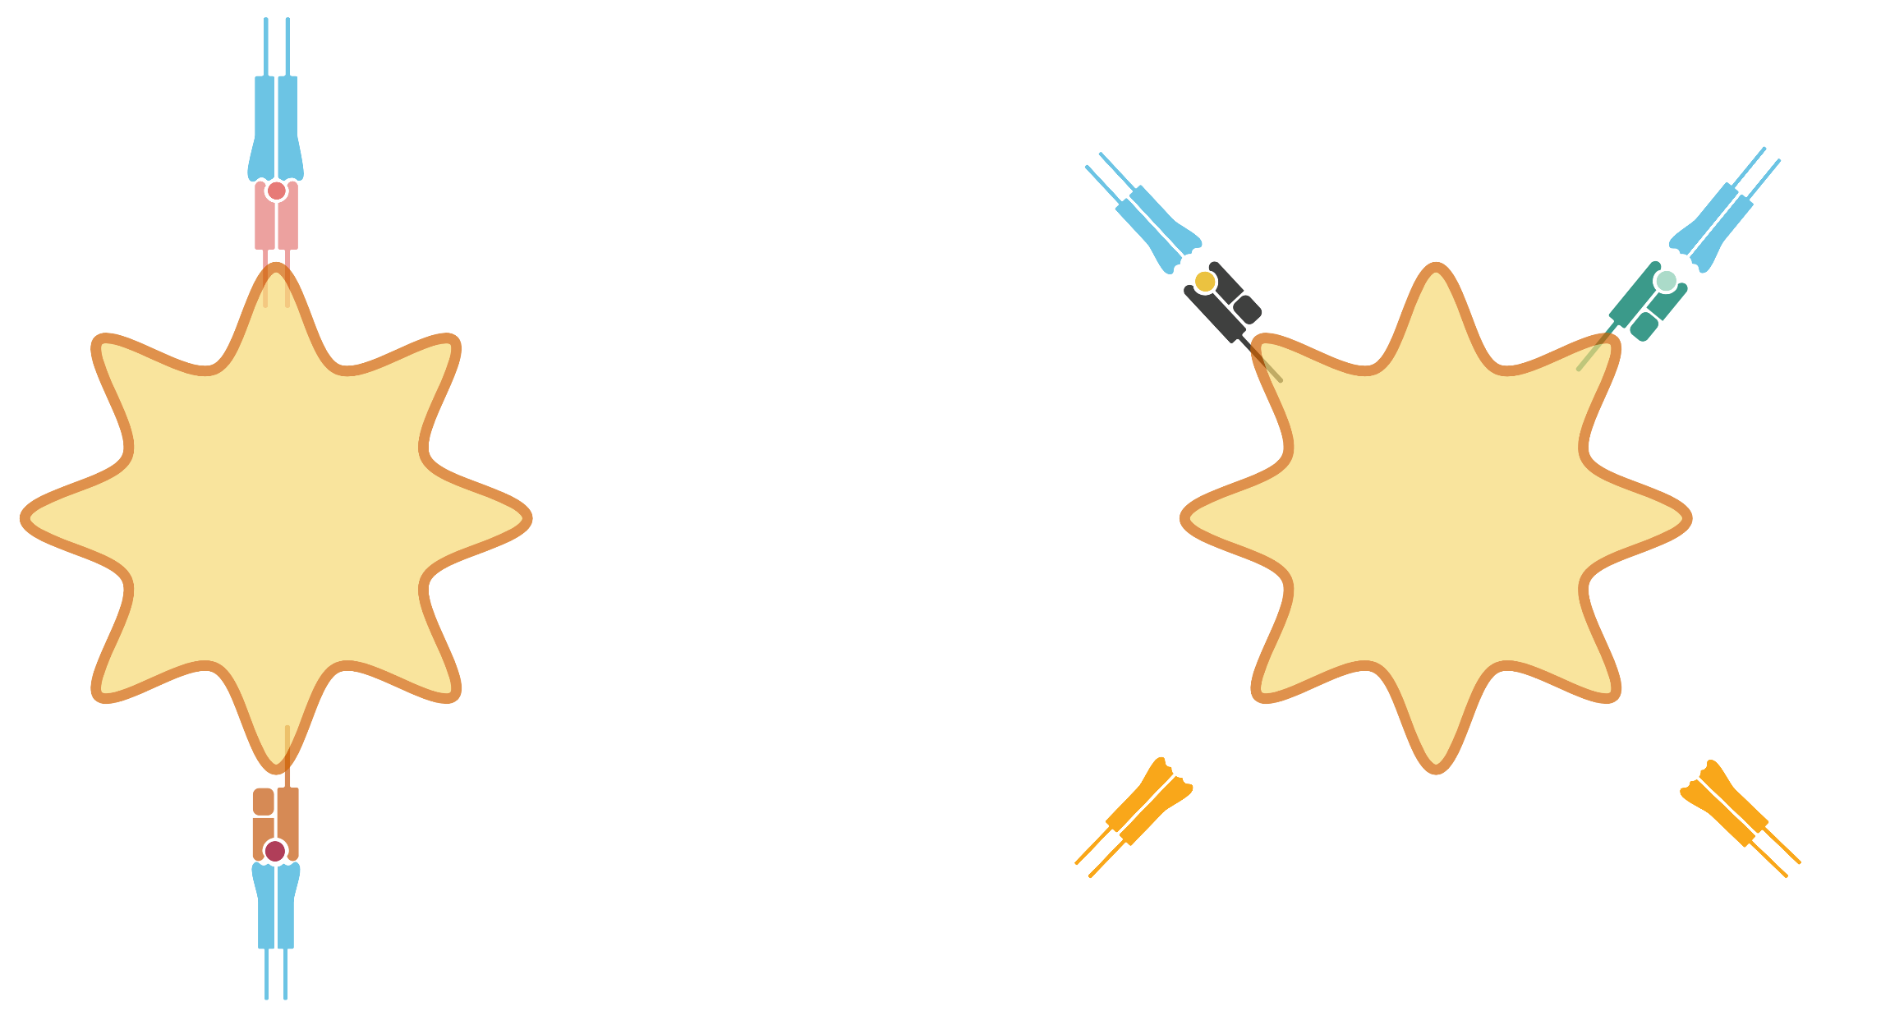
Diverse human T cell populations
MHC restricted T cells
innate T cells
CD4⁺ T
iNKT
MAIT
MHC II
CD1d
MR1
antigen
presenting
cell
antigen
presenting
cell
others
MHC I
Vδ1
γδ T cells
Vδ2
CD8⁺ T
Godfrey et al. Nat Immunol Rev. 2015
Notes:
The most studied T cells are the MHC restricted T cells that have a highly variable alpha beta T cell receptor that recognizes a wide variety of peptide antigens presented by MHC molecules. CD4 T cells recognize MHC class II, and CD8 T cells recognize MHC class I. But there are also other less conventional T cells that recognize other types of antigens presented by other proteins. For examples iNKT cells are CD1-restricted and recognize lipid antigens. MAIT cells are MR1-restricted and can recognize vitamin B derivatives, and there are these other types of T cells that express gama delta TCRs that can recognize phospoantigens but their antigens and who presents them are not completely established yet. And there are other cells within this family that I am not talking about. These unvonventional T cells play important roles in host defense, cancer, autoimune disease and allergy …. And they have properties that make them more “innate-like”. For example, they can get activated by cytokines without needing TCR activation, they are also known as poised effectors because they can have an effector response without previous antigen exposure. So because of these more innate like properties we are calling them innate T cells.

Slide 4
Objective:
Characterize transcriptomically human innate T cells
Hypothesis:
Shared effector capabilities may be driven by common transcriptional programs
Notes:
So our obejcive was to characterize transcprimtomically human innate T cells together, with the hypothesis that their shared effector capabilities may be driven by common transciprtional programs.

Slide 5
Innate T cells compose 1-25% of peripheral blood T cells
101 immuno-phenotyped
healthy individuals
Mean
Combined | 8.4%
MAIT | 2.4%
iNKT | 0.09%
Vδ1 | 1.25%
Vδ2 | 4.7%
Notes:
We quantified the abundance of different innate T cell populations in 101 healthy individuals. Combined these cell types conform 1-25% of an individuals peripheral blood T cells, with a mean of 8.4%, MAITs are on average 2.4%, iNKT close to .1 percent, Vd1 1.25% and Vd2 4.7%.
aged 20–58
Combined: 0.9-25.7%

Slide 6
Innate T cells have TCR-independent activation
Notes:
This is just to show you that these innate T cells can be actived with just cytokines and without TCR stimulation. As you can see when we stimulate these cells with IL12 and IL18, or with L12 IL18 and IFNalpha, the innate T cells are able to produce IFNG, like the NK cells, whereas the CD4 and CD8 T cells do not.

Slide 7
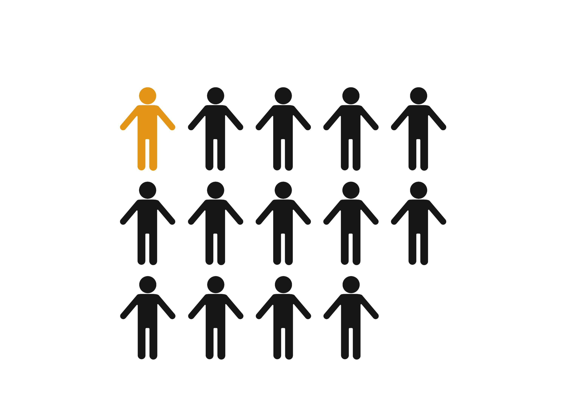
Trancsriptomic characterization of human innate T cells
PBMCs from
6 healthy donors
Flow sorted 7
cell types:
Low-input mRNA-seq on 1,000 cells (in duplicate)
Vδ2
MAIT
CD4⁺ T
NK
Vδ1
iNKT
CD8⁺ T
Notes:
We colected PBMCs form 6 healthy donors, and we flow sorted 7 cell types from each. We isolated 4 Innate T cell populations, within gamma deltas, we had Vd1 and Vd2 subsets, we isolated MAIT cells and iNKT cels. We wanted to compare them to the conventional adaptive T cells, cd4 and Cd8 T cels, and we isolated NK cells to compare them with an innate cell counterpart.
We performed low input rnaseq on 1000 cells per sample, we had each of the cell types in duplicate per individual.

Slide 8
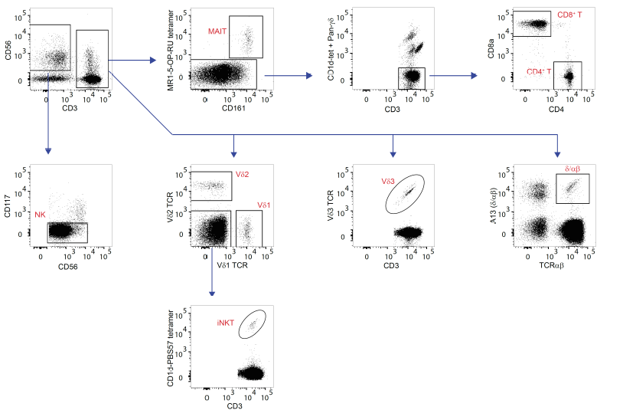
Gating strategy
NK: CD3⁻ CD117⁻CD56⁺
Vδ1: CD3⁺ Vδ1⁺ Vδ2⁻
Vδ2: CD3⁺ Vδ1⁻ Vδ2⁺
iNKT: CD3⁺ Vδ1⁻ Vδ2⁻ CD1d-PBS57tet⁺
MAIT: CD3⁺ CD161⁺ MR1-5-OPRUtet⁺
CD4+ T : CD3⁺ CD1d-tet+Panγδ⁻ CD4⁺
CD8+ T : CD3⁺ CD1d-tet+Panγδ⁻ CD8⁺
Notes:
This is our flow panel. We have our cd3 neg cd56 positive NK cells, MAIT cells were isolated with an MR1 tetramer, gamma deltas with their corresponding Vd2 TCR and Vd1 TCR antibodies, and we used a CD1d tetramer for iNKT cells.

Slide 9
Innate T cells align a continuous innateness gradient
Notes:
The first thing we did is that we measured gene expression levels, and we wanted to reduce the high dimentionality of our data while capturing the major axes of variation. So we performed principal component analysis. We can see that allon PC1 you can cd4 and cd8 t cell on one side, and NK cellson the other, with innate T cells in between. On the boxplots on the right I’ve plottet PC1 scores for each cell type separately, and you can see they form this continuous gradient along PC1. that we started calling the innateness gradient, just because cells went from the most adaptive side gradually increasing with NK cells, our innate representative, being at the top. We were intrigued by this gradient, so we asked, what are the genes that are giving us this gradient in the data.

Slide 10
Finding genes associated with innateness gradient
1,087 innateness gene
797 adaptiveness gene
1 2 3 4 5 6 7
Linear mixed model
y : expression
μ : donor random effect
x : gradient 1,2,3,4,5,6,7
Notes:
For identifying these genes we used a linear mixed model approach, were the response variable is our normalized gene expression levels, we correct for donor effects using a random effect,
And we test for associations with the gardient for which we coded cell types based on their ran in the gradient, so cd4 cells get a one, cd8 cells get a 2, and so on.

Slide 11
1,884 genes associated with innateness gradient
1 2 3 4 5 6 7
Innateness genes: 1,087
Adaptiveness genes: 797
Notes:
We found about 1K genes that associated possitively with this gradient, so we called them innateness genes, and close to 800 genes that associated negatively with this gradient and we called them adaptiveness genes. In the heatmap you can see some examples in protein coding genes, these innateness gens have low expression in purple in the adaptive side, and gradually increase their expression with highest expession in NK cells. You se the opposite pattern in adaptiveness genes. And the sema for lincRNA genes. So good, now we have a list of thousands of genes associated with the gradient, next we asked, what these genes, what is characteristic of these genes, what is the function of the genes associated positively with the gradient and what are the funcionts of the genes associated negatively with the gradient?

Slide 12
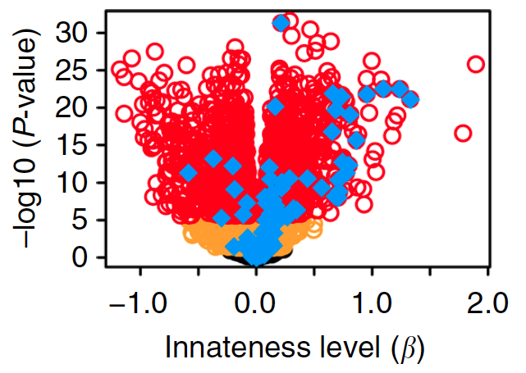
Innateness is associated with cytotoxicity, migration, cytokine and chemokine genes
NK mediated immunity
and cellular defense response
GZMB
TYROBP
GNLY
PRF1
CXC3R1
KIR3DL1
KLRK1
IFNG: preformed mRNA
active translation increases with innateness
Notes:
Next we performed pathway enrichment analysis on the innateness genes, and we found within the signficcant terms functions related to cytotoxcity and migration. Here is a volcano plot of genes plotted by their beta or innateness level, and their –log10(P value), and in blue are colored the genes pertaining to the NK mediated immunity and cellular defense response GO terms. You can see they are mostly on the innatenes side of the plot, some examples are GZMB, Tyrobp, granulysine, perforing, cxc3R1 kir receptors… And here are plotted the transcript levels of the gene that codes for granulysin. You can see how it’s expression follows the gradient. Patrick did protein level validations of many genes, here is the granulysing example with protein levels in the x-axis and transcript levels on the y-axis.

Slide 13
Cytokine and chemokine genes
are associate with innateness
IFNG
P = 1.7e–06
IFNG: preformed mRNA
active translation increases with innateness
Notes:
We also observed that some cytokines such as IFNG were innateness genes, and since many cytokines are lowly expressed, we summed up the transcript levels from all of the cytokines, and you can see the amount of total cytokine encoding transcripts correlates with innateness. So this suggests that innate T cells are upregulating their cytokine genes to have mRNA ready to be rapidly translated when they get stimulated.

Slide 14
Cytokine and chemokine genes
are associate with innateness
IFNG
P = 1.7e–06
Notes:
We also observed that some cytokines such as IFNG were innateness genes, and since many cytokines are lowly expressed, we summed up the transcript levels from all of the cytokines, and you can see the amount of total cytokine encoding transcripts correlates with innateness. So this suggests that innate T cells are upregulating their cytokine genes to have mRNA ready to be rapidly translated when they get stimulated.

Slide 15
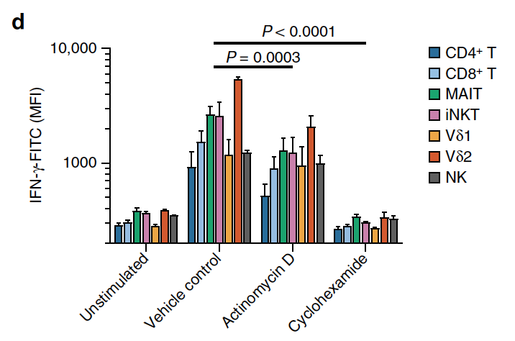
IFNG is in preformed mRNA state ready to be translated
Transcription
Translation
2 hrs after PMA/I stimulation
Notes:
So we tested this hypothesis by measuring IFNG protein levels in all of the cell types, and you can see in unstimulated cells, IFNG is overall low, if you stimulate the cells with PMA Ionomycin, IFNG levels are high, if you block translation with cyclohexmide, you basically block IFNG production, but if you block transcription, there is still a lot of IFNG that is produced, indicating that the IFNG is in the presence of pre-formed mRNA, ready to be translated as soon as the cells get the signal. This is a general pattern across all cell types, they are storing some IFNG as pre-formed mRNA, but innate T cells and NK cells have more transcripts for IFNG and other cytokines ready to be translated.

Slide 16
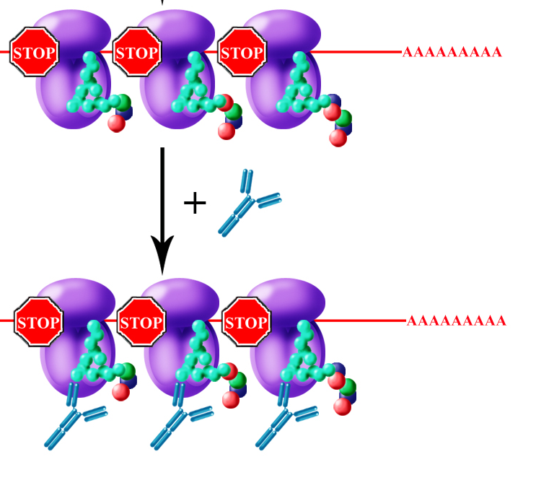
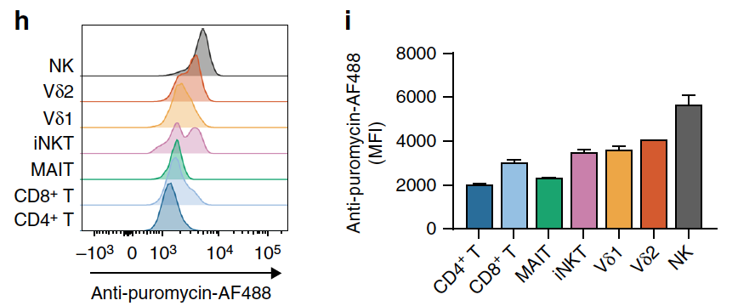
Active translation is associated with innateness
Notes:
We also measured the amount of active tranlation in these cells with a ribopuromycilation assay. Were cells are treated with ribopuromycin, which gets stuckk in ribosome that are actively translating at that time, and then we measure the amount of ribopuromycin stuck, we we are measuring the amount of active translation. So it turns out that the amount of active translation also follows the innateness gradient, with innate side having higher amounts of active translation, which suggessts this could be part of this readiness to react to a stimulus.

Slide 17
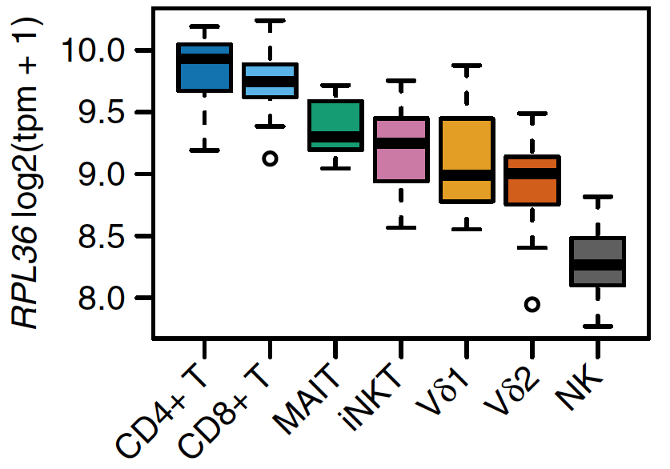
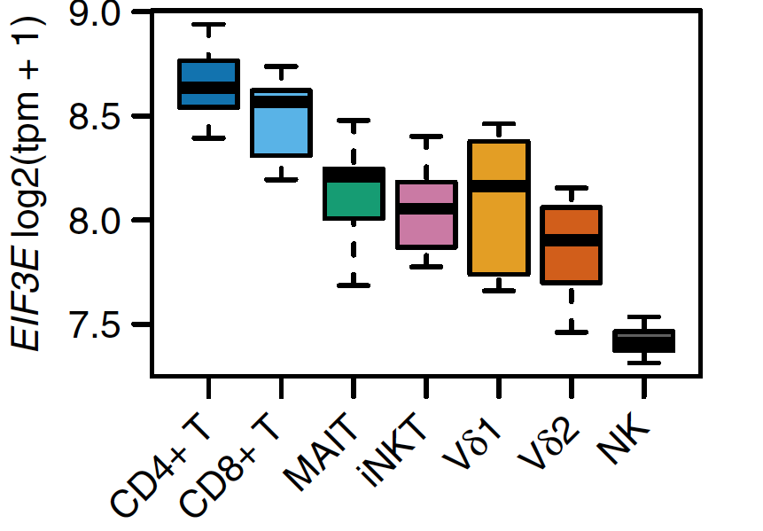
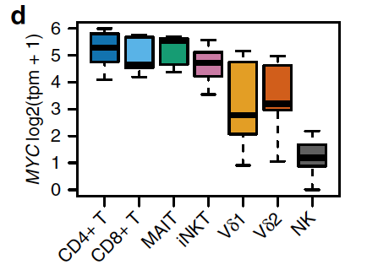
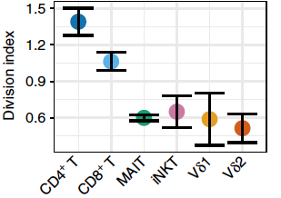
Adaptiveness is associated with translation machinery
and proliferative capacity
RPL36
EIF3E
MYC
(anti-CD3/CD28 bead
stimulation)
Notes:
We then looked at the adaptiveness genes, and to which pathways they belonged to. We most of the significant pathways were related to ribosomes and translation activity. For example, out top GO term was “cytosolic ribosome”. And in blue are all the genes that have that GO term. You can see they are many and most of them on the adaptiveness side, although with small effect sizes. Here is an example of the RPL36 gene. And we saw that this type of pattern was true not only for mRNA coding for ribosomal proteins, but for mRNA encoding for other genes in the translation machinery, like elongation factors. And our top adaptivenes TF was MYC, who is known to regulate rRNAs. So we then quantified with qPCR the 47S ribosomal RNA precursor and saw that it correlated with adaptiveness. So after these findings we thought, well, may be all these things together mean adaptive T cells are prioritizing proliferation over effector functions.

Slide 18
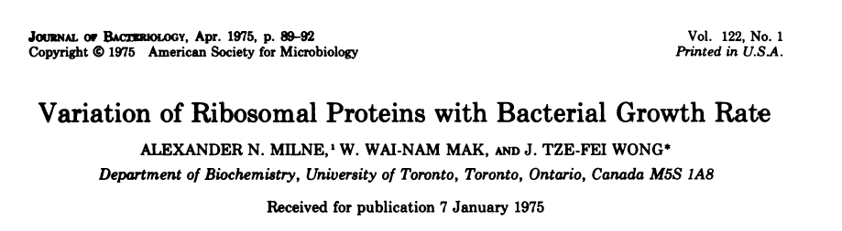

Slide 19
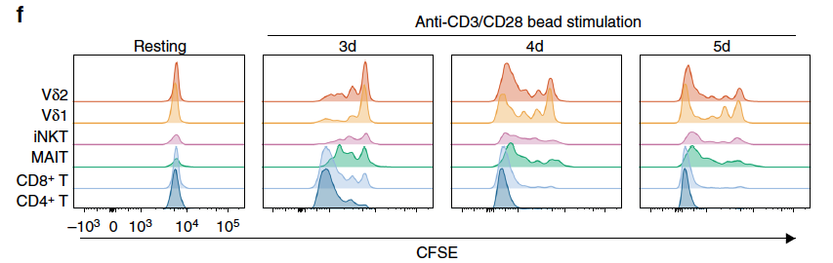
Adaptiveness is associated with proliferation
Notes:
So we stimulated the different T cell populations with anti-CD3/CD28 beads and measured their proliferation with CFSE. You can see that at 3 days, most of the adaptive T cells have divided several times already, whereas in innate T cells, there is a wider variation of cell dividions, with a lot of the cells not having divided yet. At 4 and 5 days you still see this lag in cell dividiosn in innate T cells. On the bottom we plotted the division index per cell type, and you can see this follows an adaptiveness trend.

Slide 20
Transcriptional innateness gradient
“effector” transcriptome
early cytokine production
translation machinery transcripts
proliferative capacity
Σ
score
Notes:
So overall, this transcriptional signatures and functional assays are telling us that as you increase innateness, you downregulate ribosomal machinery transcprpts and sacrifice proliferative capacity, while upregulating the effector transcriptome to make sure you get rapid cytokine production and response.

Slide 21
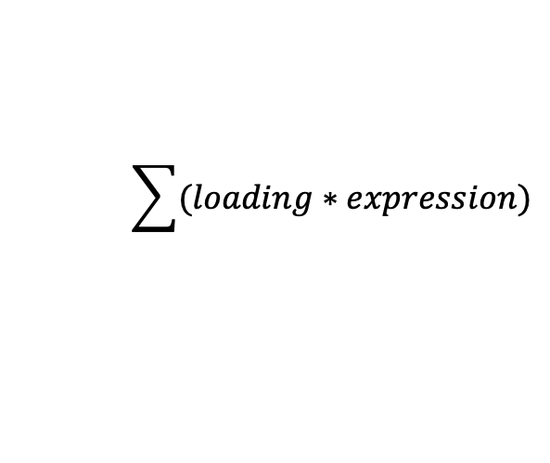
How we calculate the “innateness score”
Original PCA with low input RNA-seq
on top ~1000 variable genes
Gene expression levels
in sample or cell of
dataset X
Gene loadings
for PC1
X
Gene 1 -3 2.4
Gene 2 -1 4.1
Gene 3 2 9
Gene4 5 7
$$\sum{(loading∗expression)}$$
score =

Slide 22
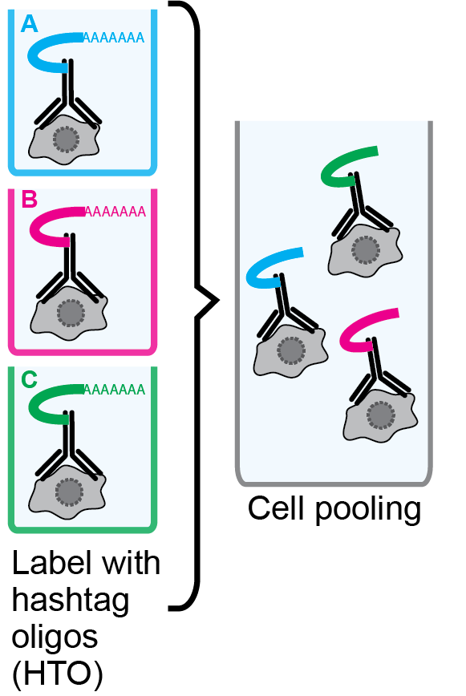
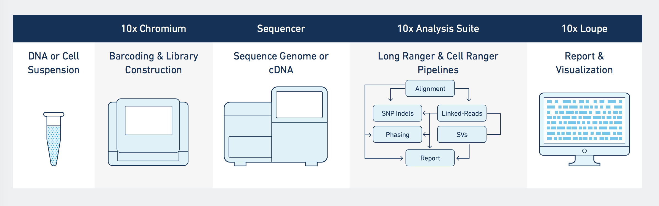

Single-cell RNA-seq with cell hashing
Stoeckius et al., 2018, Genome Biology
Notes:
Finally, we performed scRNA-seq ourselves on the same cell populations, from 2 donors, and using hashing antibodies from the CITE-seq protocol, we were able to collect euql proportions of cells form each cell type and put them all on one 10X run. If we project the cells on UMAP space, you can see they overal cluster by cell type, and we can see again the ainnateness gradient if we color each cell by their innateness score,

Slide 23
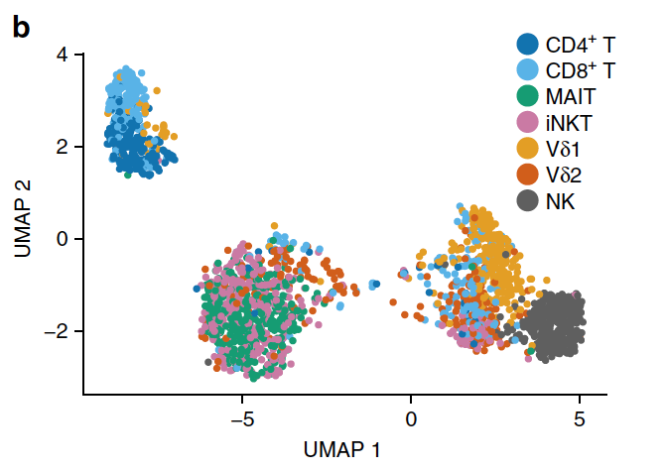
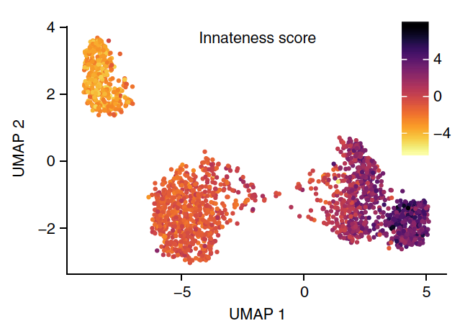
Single-cell RNA-seq reveals 4 innateness gradient states
Notes:
Finally, we performed scRNA-seq ourselves on the same cell populations, from 2 donors, and using hashing antibodies from the CITE-seq protocol, we were able to collect euql proportions of cells form each cell type and put them all on one 10X run. If we project the cells on UMAP space, you can see they overal cluster by cell type, and we can see again the ainnateness gradient if we color each cell by their innateness score,

Slide 24
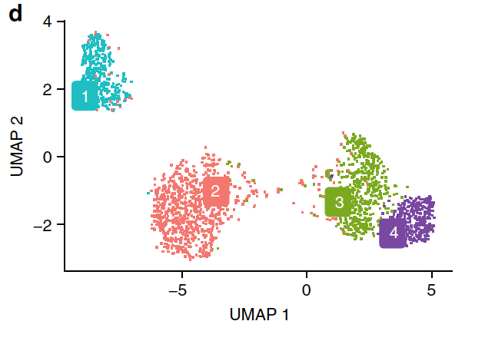
Single-cell RNA-seq reveals 4 innateness gradient states
Notes:
Finally, we performed scRNA-seq ourselves on the same cell populations, from 2 donors, and using hashing antibodies from the CITE-seq protocol, we were able to collect euql proportions of cells form each cell type and put them all on one 10X run. If we project the cells on UMAP space, you can see they overal cluster by cell type, and we can see again the ainnateness gradient if we color each cell by their innateness score,

Slide 25
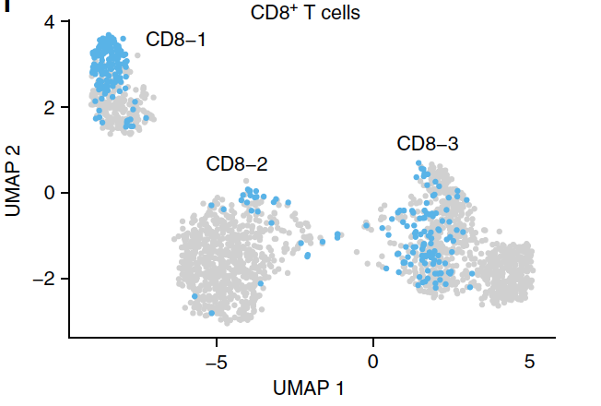
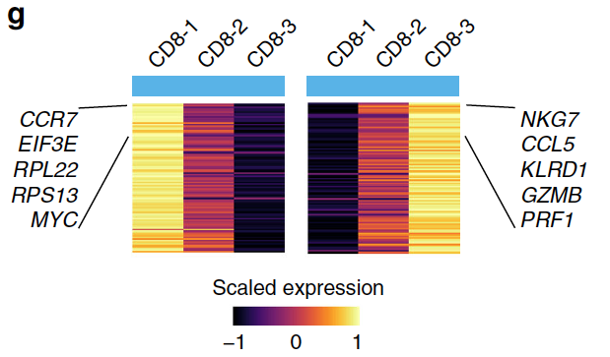
Heterogeneity in innateness state within cell-types
Notes:
If we cluster cells, these cluster into 4 clusters, that we are calling innateness states. And if we look at the cells form each cell type that are in each cluster, you can see there is some heterogeneity. For example, CD8 T cells are found the majorrity in clsueter 1 with the CD4s, but some on cluster 2, and sume on cluster 3. And if we check which genes are differentially expressed in these subsets, we can see they are again the innateness and adaptiveness genes.

Slide 26
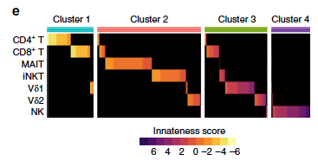
Heterogeneity in innateness state within cell-types
Notes:
If we cluster cells, these cluster into 4 clusters, that we are calling innateness states. And if we look at the cells form each cell type that are in each cluster, you can see there is some heterogeneity. For example, CD8 T cells are found the majorrity in clsueter 1 with the CD4s, but some on cluster 2, and sume on cluster 3. And if we check which genes are differentially expressed in these subsets, we can see they are again the innateness and adaptiveness genes.

Slide 27
Innateness state varies within CD8⁺ T cell subsets
HCMV infected individuals
Public microarray data from Hertoghs et al. 2010, J. Clin. Invest.
Notes:
We then wanted to know if this innateness level was generalizable within adaptive subsets, as CD4 and CD8 T cells can have effector fuctions too. And at the same time we wanted to see how innateness is in disease states. So we deviced an innateness score that basically just takes the PC1 loadings of the genes we used in PCA, and multiplies them by their expression level in the sample of interest, and you sum that up and you get an innateness score, the higher the score the higher your innate transcriptomic signature. First we looked in a microarray expression dataset on HCMV infected individuals, where you can see naïve CD8 T cells are less innate then HCMV-specific memory CD8 T cells, and these are less innate than effector CD8+ T cells. We found a similar trend when we looked at low input RNA seq on CD4 T cells subsets in rheumatoid arthritis and osteoarthirtis patients. With the highest innateness in the effector subset that was exapnded in rheumatoid arthritis patients. And finally we looked a single cell ranse qdataset where they sorted immune cell types from breast tissue of 8 cancer patients, and as you can see, T cells in the tumour show overall more innateness than the T cells found in normal breast tissue.

Slide 28
Innateness state is increased in disease-associated cells
Arthritis patients
Breast cancer single-cells
Public low input RNA-seq data
from Fonseka et al. 2018, Sci. Transl. Med.
Public single-cell RNA-seq data
from Azizi et al. 2018, Cell
Notes:
We then wanted to know if this innateness level was generalizable within adaptive subsets, as CD4 and CD8 T cells can have effector fuctions too. And at the same time we wanted to see how innateness is in disease states. So we deviced an innateness score that basically just takes the PC1 loadings of the genes we used in PCA, and multiplies them by their expression level in the sample of interest, and you sum that up and you get an innateness score, the higher the score the higher your innate transcriptomic signature. First we looked in a microarray expression dataset on HCMV infected individuals, where you can see naïve CD8 T cells are less innate then HCMV-specific memory CD8 T cells, and these are less innate than effector CD8+ T cells. We found a similar trend when we looked at low input RNA seq on CD4 T cells subsets in rheumatoid arthritis and osteoarthirtis patients. With the highest innateness in the effector subset that was exapnded in rheumatoid arthritis patients. And finally we looked a single cell ranse qdataset where they sorted immune cell types from breast tissue of 8 cancer patients, and as you can see, T cells in the tumour show overall more innateness than the T cells found in normal breast tissue.

Slide 29
Conclusions
Innateness gradient
- ribosomal machinery
transcripts
- proliferative capacity
+ “effector” transcriptome
+ rapid cytokine production
Innateness:
Strong in adaptive T cell effector subsets
Present in disease states
Heterogeneity within T cell populations
Browse expression for particular genes in:
https://immunogenomics.io/itc
Notes:
So to conclude, besides the take home of this innateness gradient being a balance between effector fucntion and proliferative capacity, we showed that this inateness metric is applicable in adaptive subsets too, and is a signature of disease states, and that there is heterogeneity within cell types that we need to explore more.

Slide 30
Conclusions
Lymphocytes align along a transcriptional gradient reflecting innateness state
Innateness
- “effector” transcriptome
- early cytokine production
Adaptiveness
- ribosomal machinery
transcripts
- proliferative capacity
Innateness state in T cells:
varies within CD4 and CD8 T cell subpopulations
is increased in autoimmune pathogenic subset and
tumor microenvironment
CD4⁺
CD8⁺
iNKT
MAIT
Vδ1
Vδ2
NK
Notes:
So to conclude, besides the take home of this innateness gradient being a balance between effector fucntion and proliferative capacity, we showed that this inateness metric is applicable in adaptive subsets too, and is a signature of disease states, and that there is heterogeneity within cell types that we need to explore more.

Slide 31
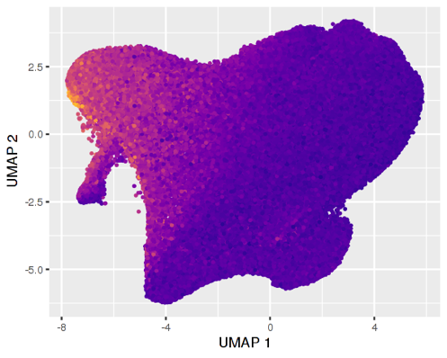
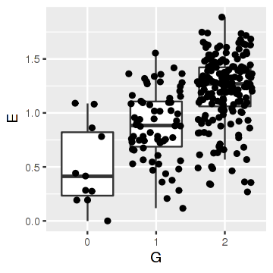
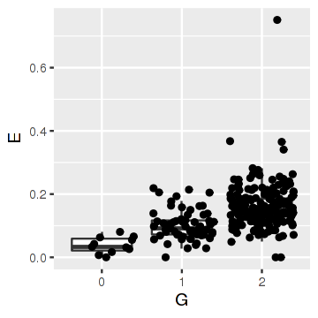
Innateness score helps understand memory T cell states
and cell state-dependent genetic regulatory effects
496,523 memory T cells from 257 individuals
exposed to M. tuberculosis
Plots by Aparna Nathan
Nathan et al. Nature 2022

Slide 32




Acknowledgements
Soumya Raychaudhuri
Yuriy Baglaenko
Jatin Arora
Susan Hannes
Yang Luo
Tiffany Amariuta
Nikola Teslovich
Aparna Nathan
Kamil Slowikowski
Ilya Korsunsky
Hyun Kim
Patrick Brennan
Alex Mola
Rafael Polidoro
Gerald Watts
Michael Brenner
Deepak Rao
Joerg Ermann
Helena Jonsson
Peter Gregersen
Cristina Navarrete
Tonu Esko
Jerome Rotter
Stephen Rich
Kent Taylor
Notes:
I would like to acknowledge all the pople that contributed to these projects. In particular Soumya Raychaduhri who hwas been an amazing adviror, and Patrick Brennan my collaborator.

Slide 33
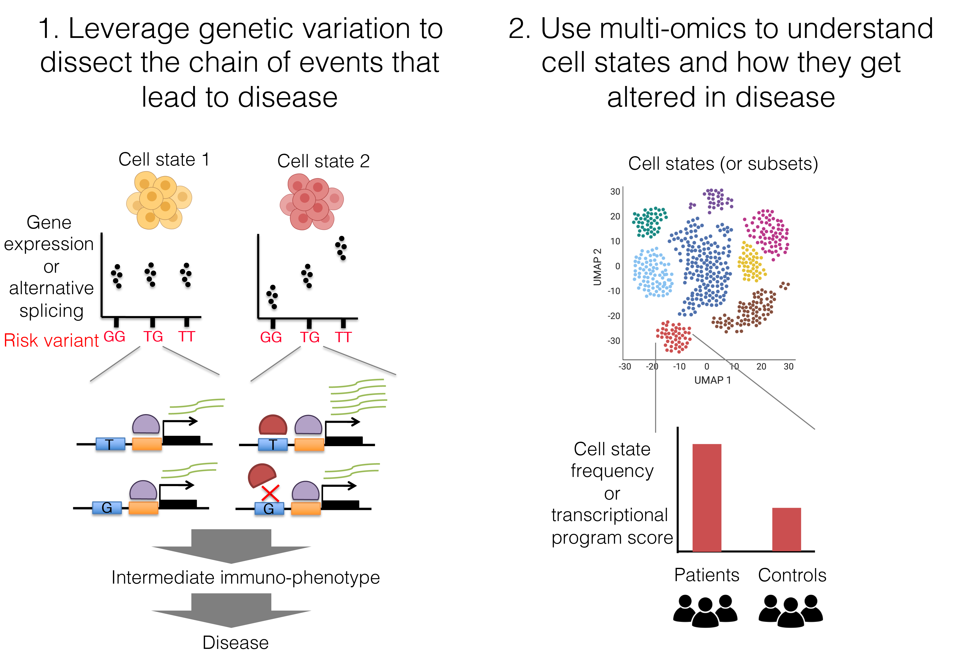
Objectives of Gutierrez-Arcelus Lab
Lupus
Asthma and
allergic diseases
MIS-C
Axial Spondyloarthritis
Tuberculosis

Slide 34


mgutierr@broadinstitute.org
gutierrezarceluslab.com
@mariaGTAC

